Slide 1
Simulate the robot in Gazebo
Understand TFs
Design a custom robot with URDF
Simulate the robot in Gazebo

Slide 2
Broadcast TFs with the Robot State Publisher

Slide 3
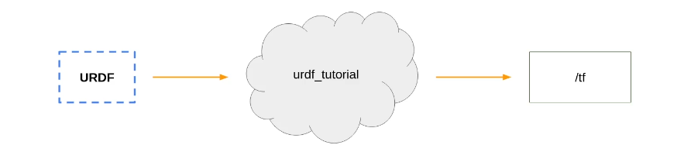
Introduction
Create and package a ROS 2 application, around URDF
This process can be applied to any robot

Slide 4
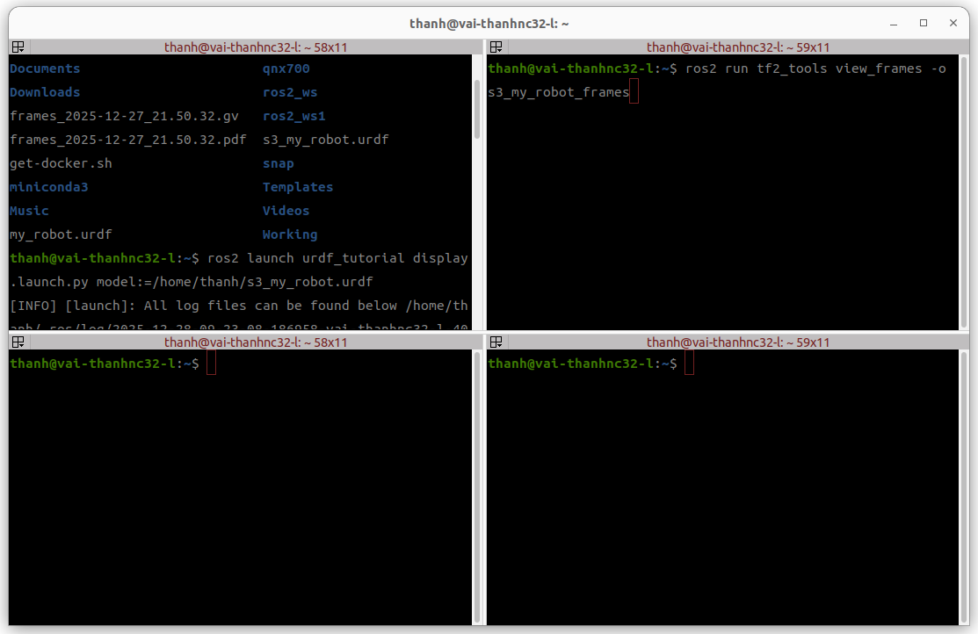
How the Robot State Publisher and URDF Work Together

Slide 5
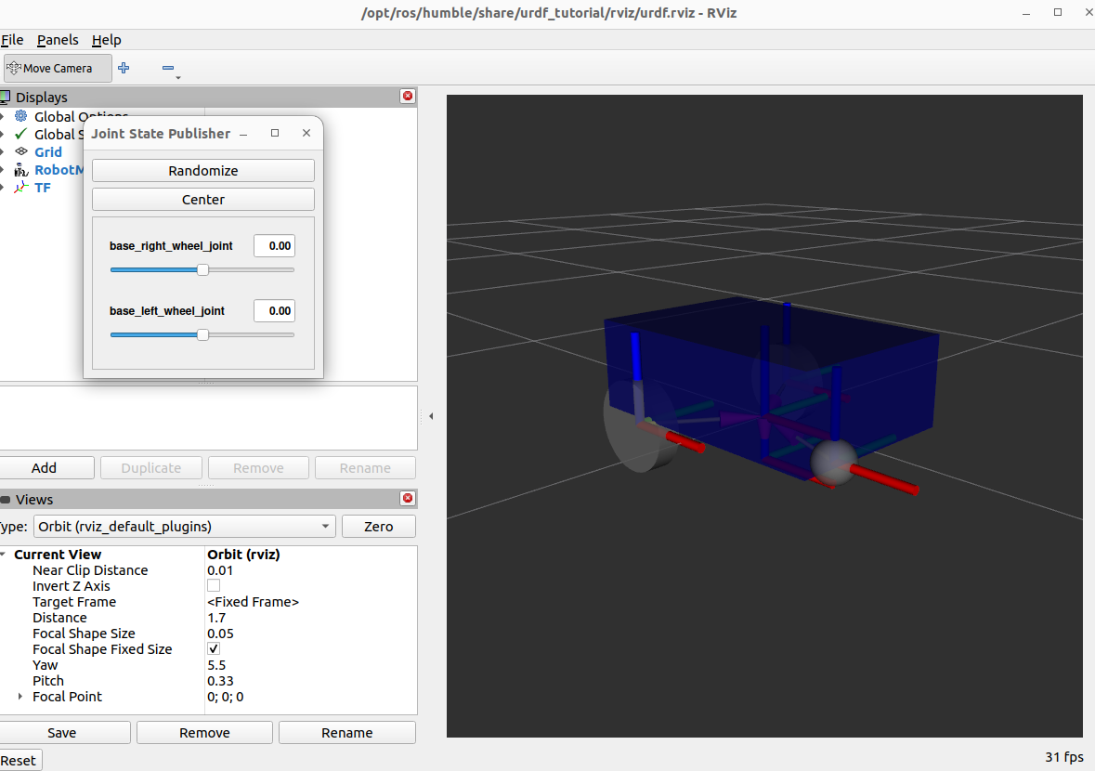
How the Robot State Publisher and URDF Work Together

Slide 6
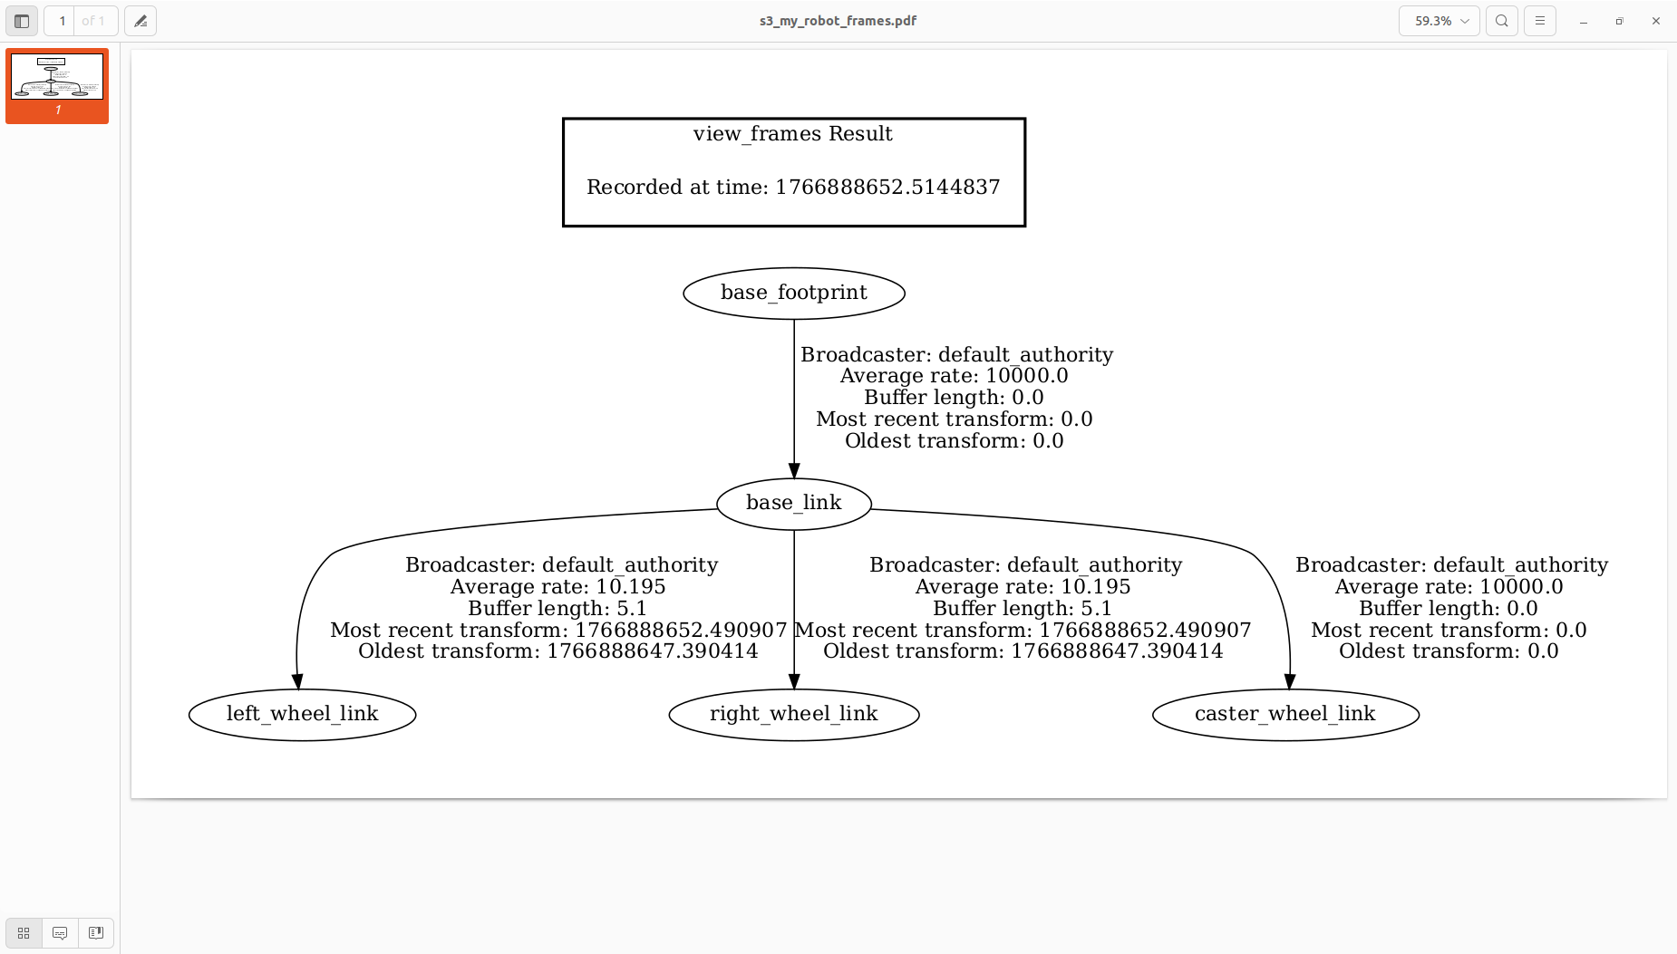
How the Robot State Publisher and URDF Work Together

Slide 7
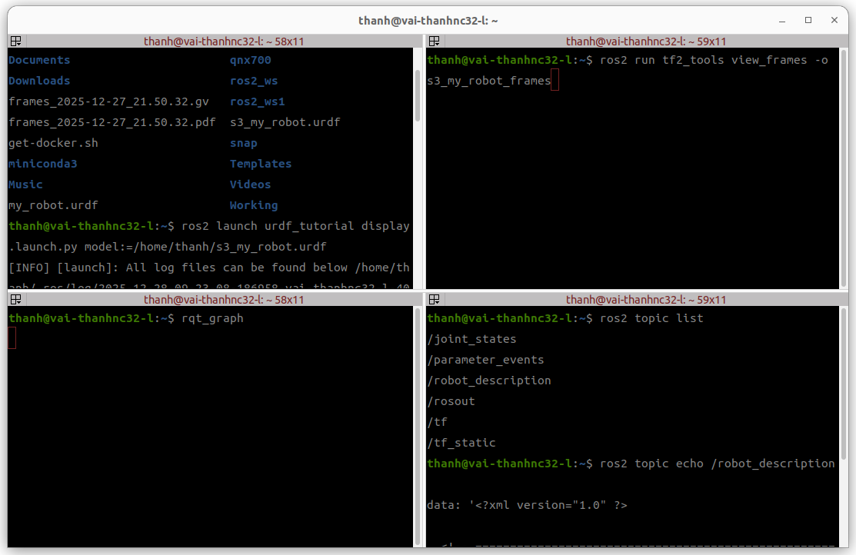
How the Robot State Publisher and URDF Work Together

Slide 8
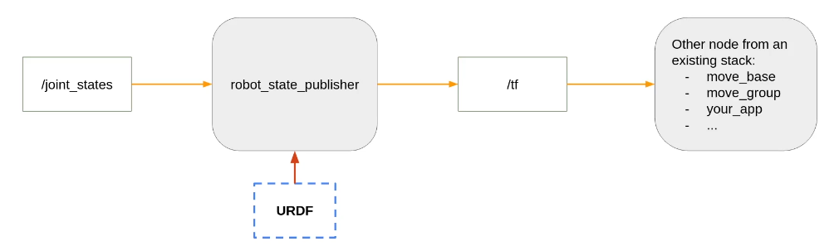
How the Robot State Publisher and URDF Work Together

Slide 9
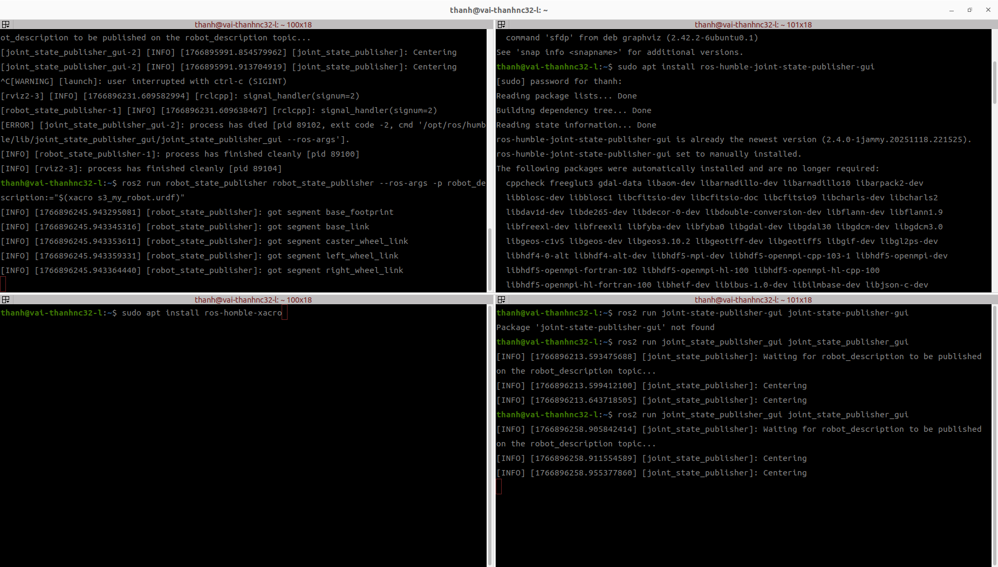
Run the Robot State Publisher with URDF in the Terminal (Command Line)

Slide 10
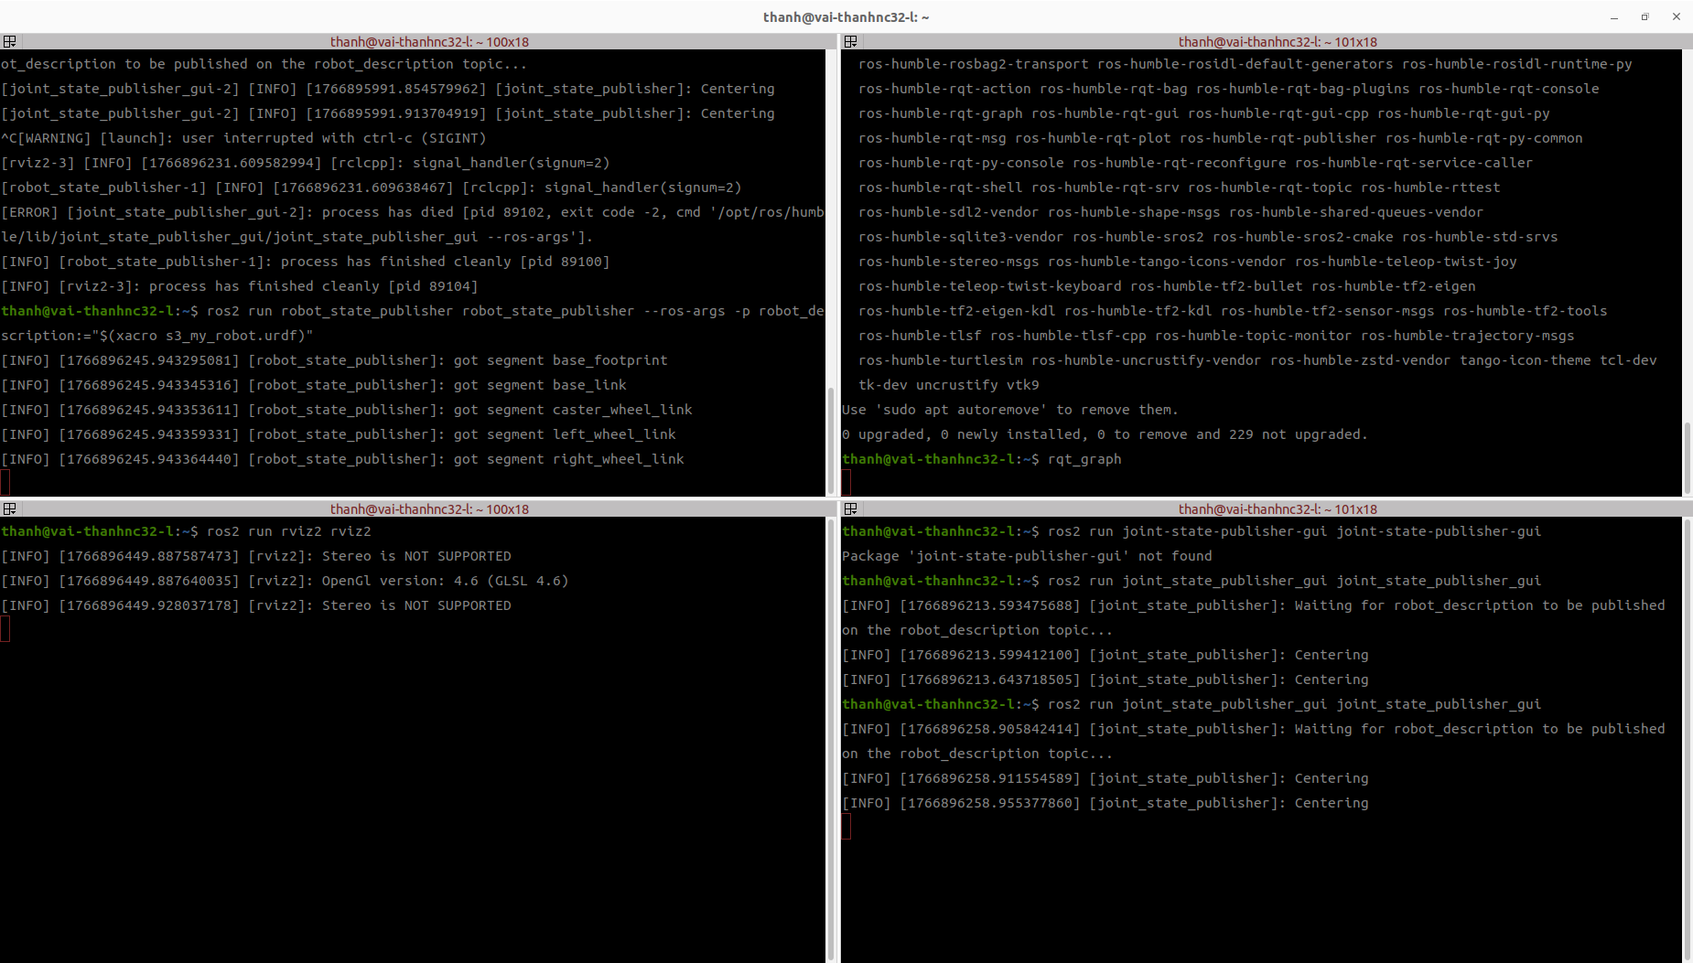
Run the Robot State Publisher with URDF in the Terminal (Command Line)

Slide 11
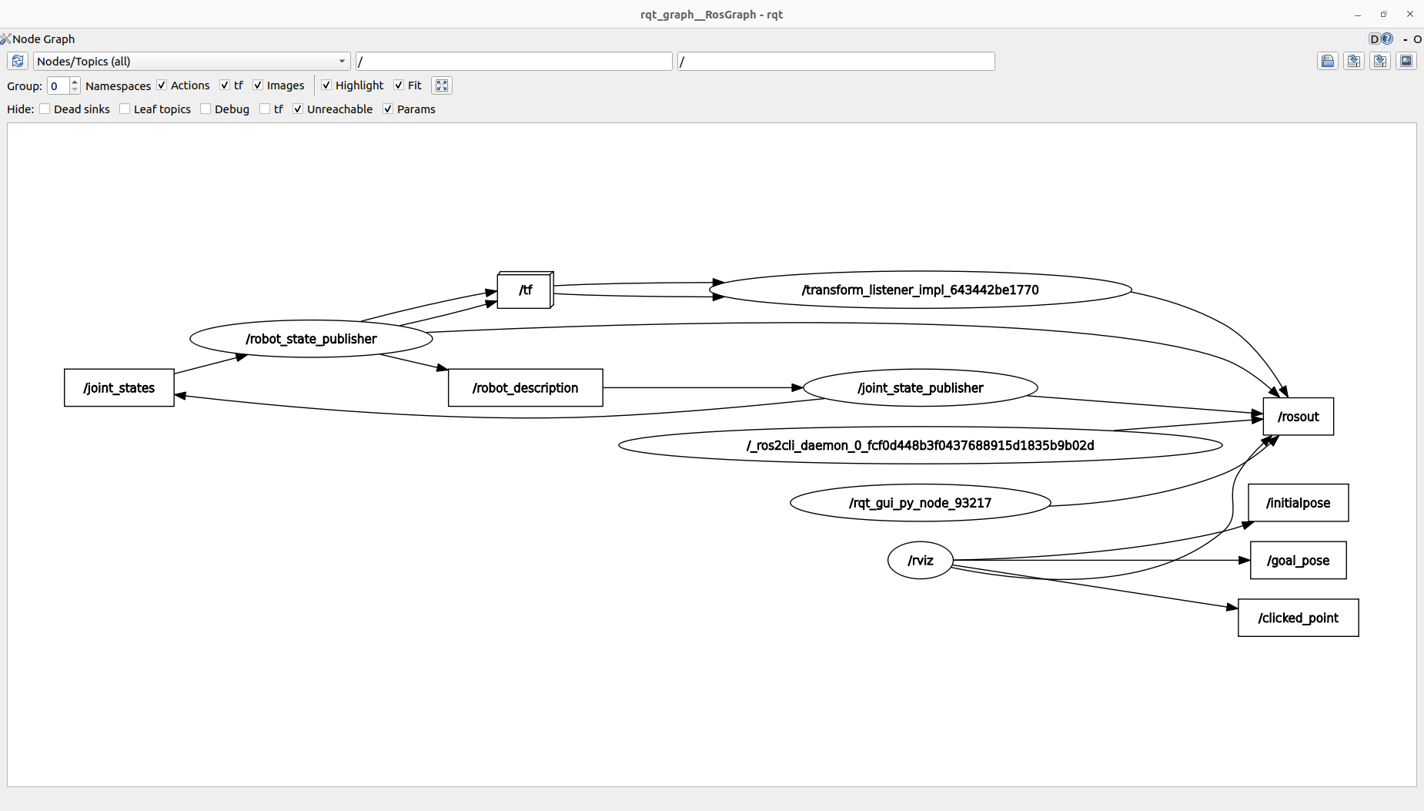
Run the Robot State Publisher with URDF in the Terminal (Command Line)
Open rqt_graph

Slide 12
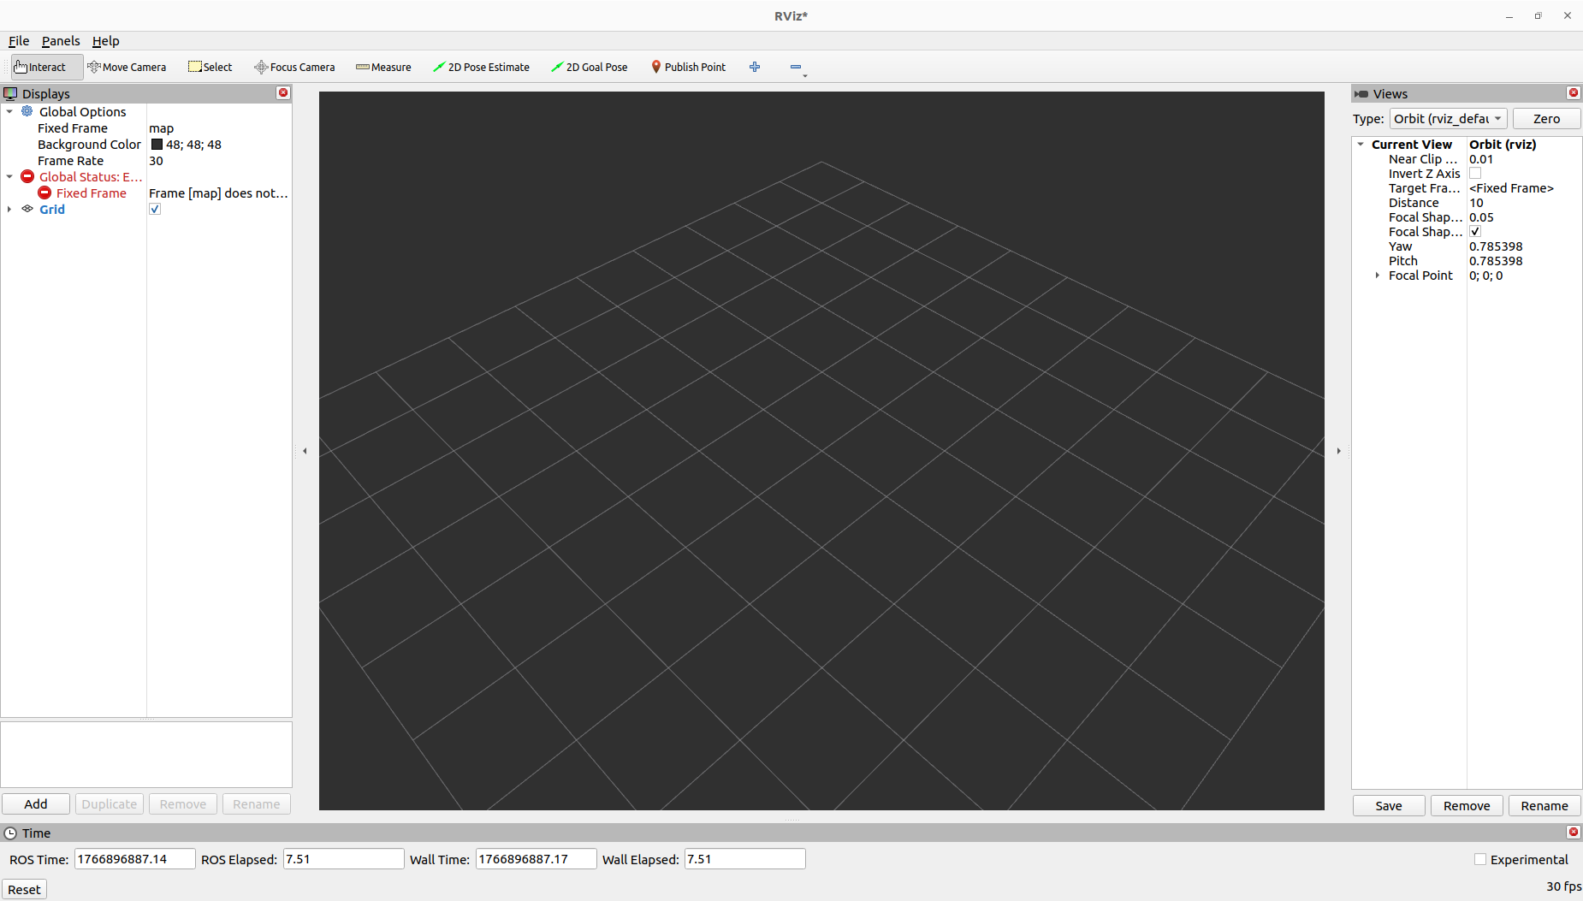
Run the Robot State Publisher with URDF in the Terminal (Command Line)
Open rviz2

Slide 13
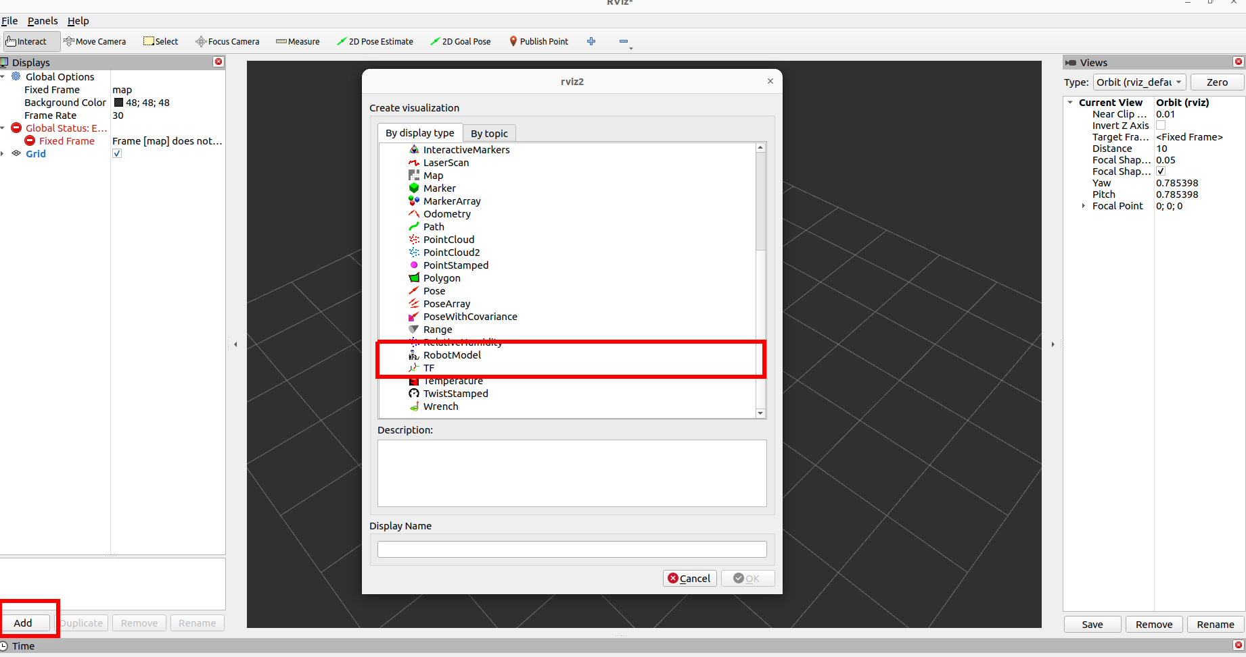
Run the Robot State Publisher with URDF in the Terminal (Command Line)
Add RobotModel and TFs

Slide 14
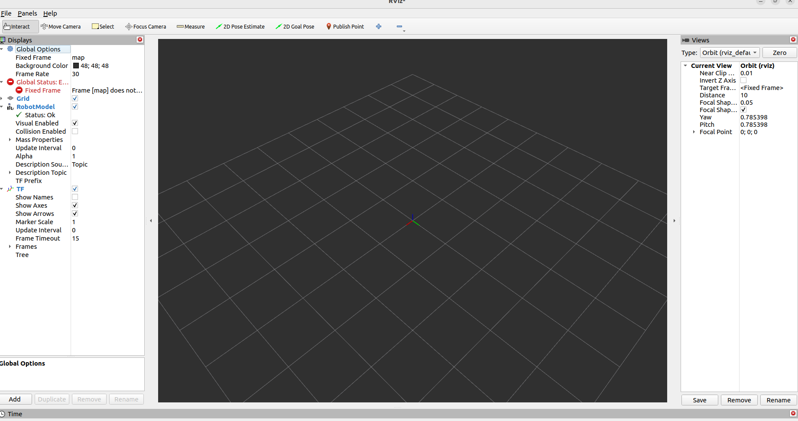
Run the Robot State Publisher with URDF in the Terminal (Command Line)
Add RobotModel and TFs

Slide 15
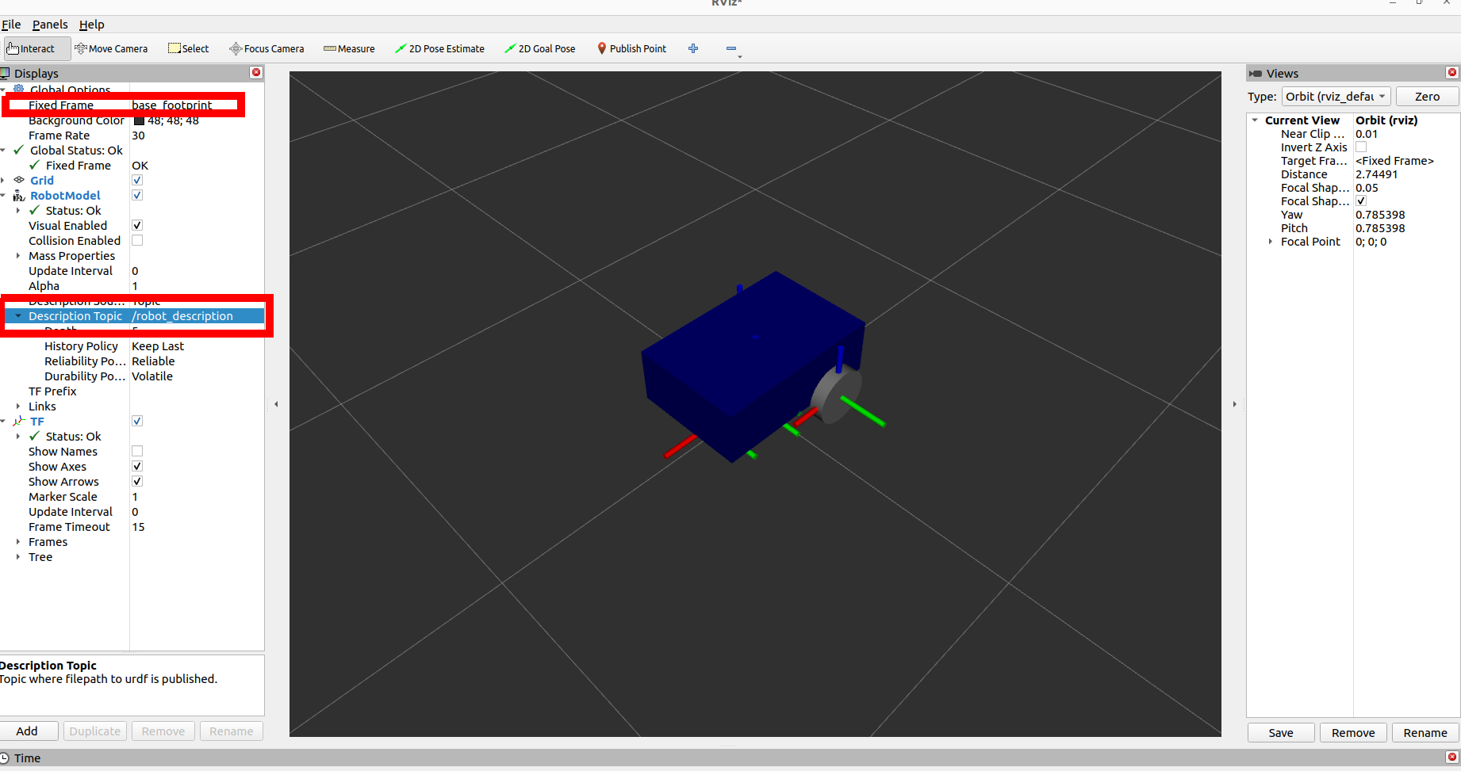
Run the Robot State Publisher with URDF in the Terminal (Command Line)
Select Frame and Description Topic

Slide 16
Create a Robot Description Package to Install the URDF
Create package my_robot_description
cd ros2_ws/src
ros2 pkg create my_robot_description
cd my_robot_description
rm -r /include /src
mkdir urdf
Copy s3_my_robot.urdf to ros2_ws/src/my_robot_description/urdf/
Open vs code in rps2_ws/src/
cd
mv s3_my_robot.urdf ros2_ws/src/my_robot_description/urdf/
cd ros2_ws/src/
code .

Slide 17
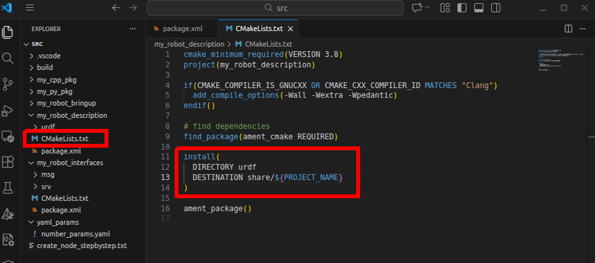
Create a Robot Description Package to Install the URDF
Modify the Cmakelist.txt
build the package my_robot_description or all packages in workspace ros2_ws
cd
cd ros2_ws
colcon build
go to next step

Slide 18
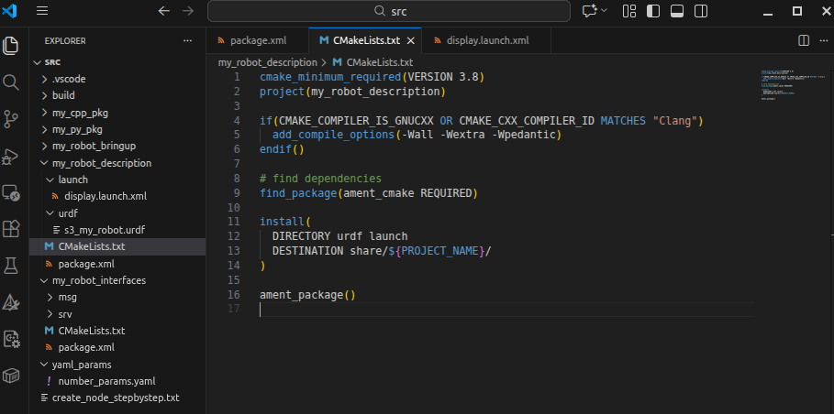
Write a Launch file to Start the Robot State Publisher with URDF (XML)
Modify the Cmakelist.txt
by add launch

Slide 19
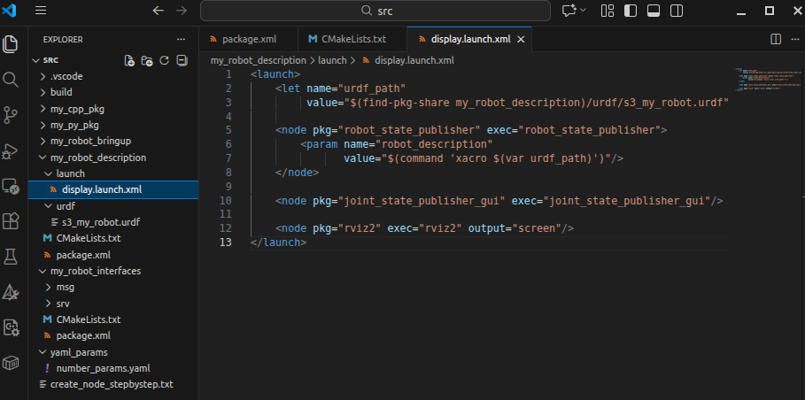
Write a Launch file to Start the Robot State Publisher with URDF (XML)
Create folder launch and create a file display.launch.xml

Slide 20
Write a Launch file to Start the Robot State Publisher with URDF (XML)
Build the my_robot_description by colcon build
Launching my_robot_description on terminal
ros2 launch my_robot_description display.launch.py

Slide 21
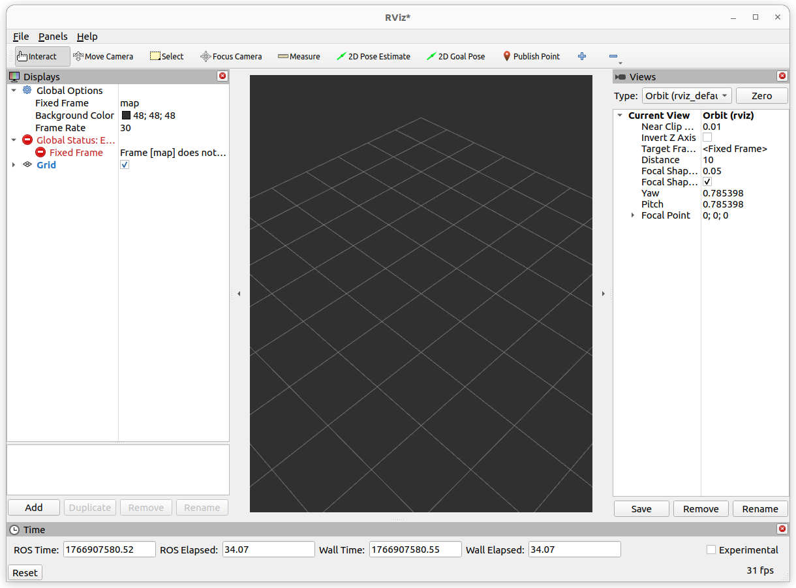
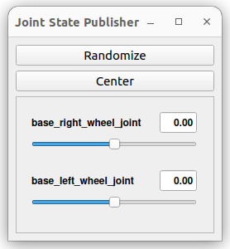
Write a Launch file to Start the Robot State Publisher with URDF (XML)
The rviz2 is launched

Slide 22
Write a Launch file to Start the Robot State Publisher with URDF (XML)
Select Frame and Description Topic

Slide 23
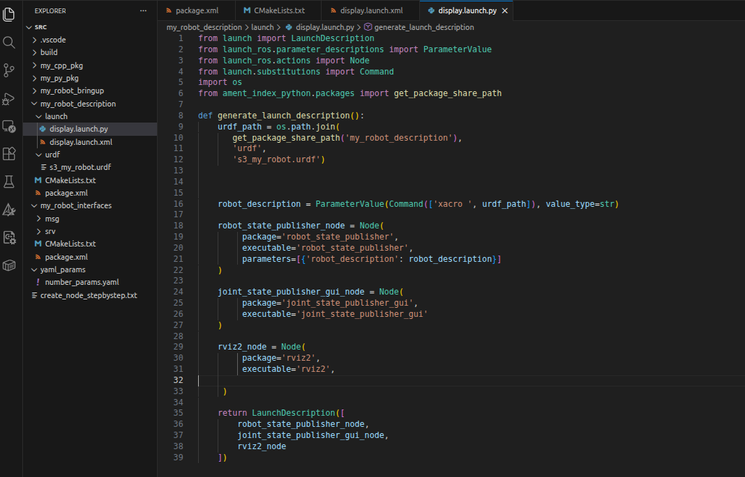
Python Launch File
Create display.launch.py in folder launch

Slide 24
Python Launch File
Build the my_robot_description by colcon build
Launching my_robot_description on terminal
ros2 launch my_robot_description display.launch.py

Slide 25
Python Launch File
The rviz2 is launched

Slide 26
Python Launch File
Select Frame and Description Topic

Slide 27
Add Rviz Config in the Launch File
Save config As from Rviz2 to my_robot_description/rviz/ with name: urdf_config.rviz
Add rviz_config_path into display.launch.py
add rviz into install option in Cmakelist.txt

Slide 28
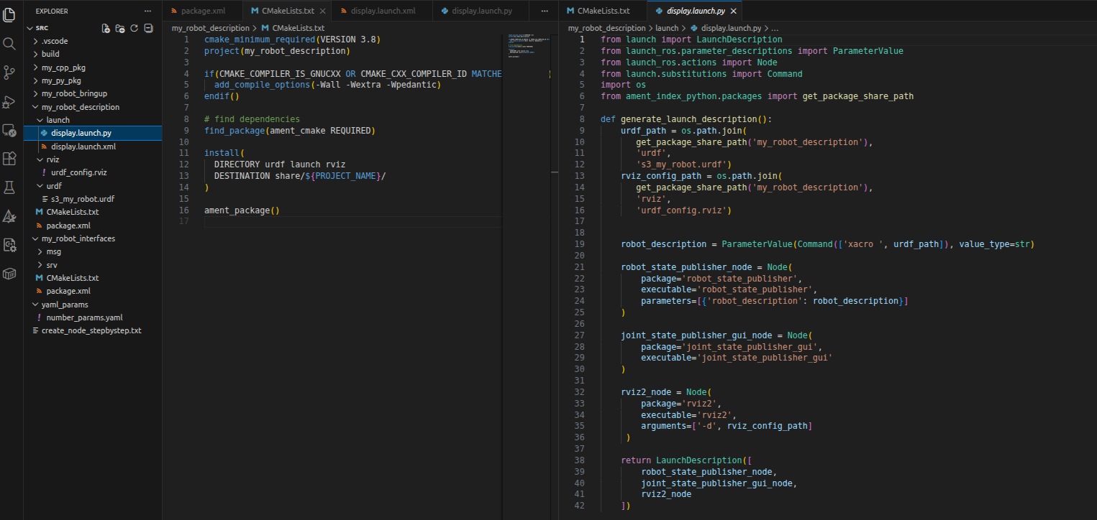
Add Rviz Config in the Launch File

Slide 29
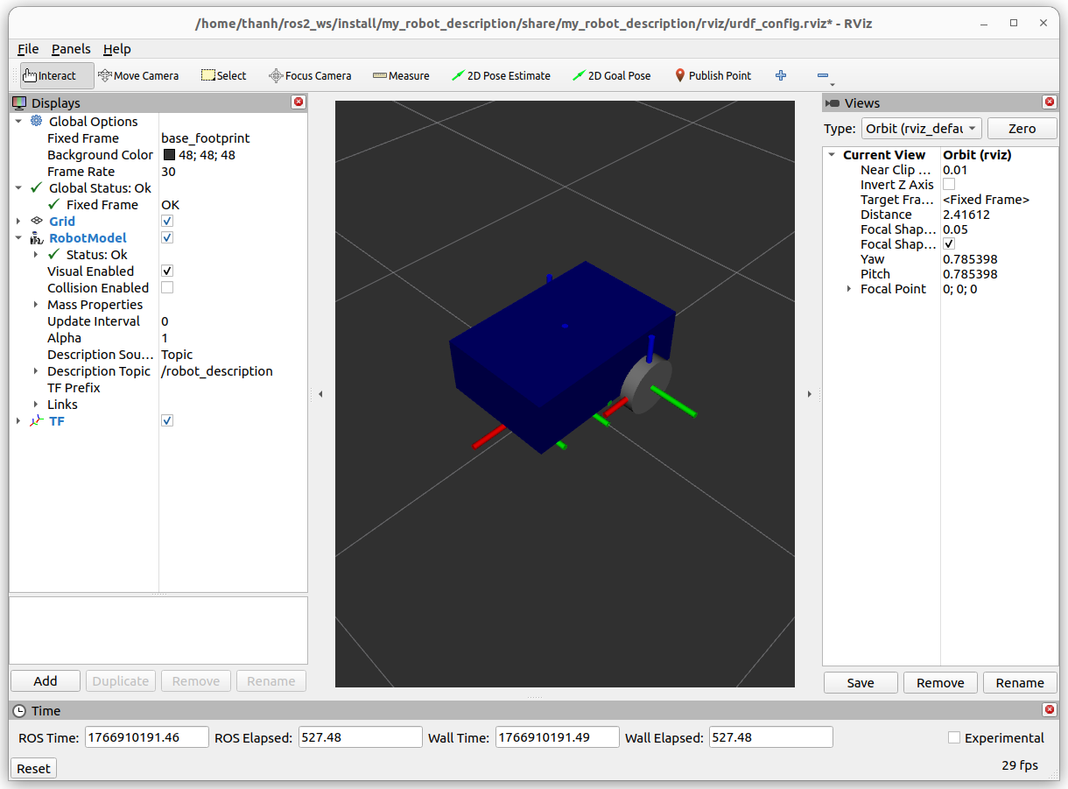
Add Rviz Config in the Launch File
Build my_robot_description by colcon build
launch by python launch file

Slide 30
Improve URDF with Xacro

Slide 31
Introduction
Properties (variables)
Macros (functions)
Include URDF file inside onather URDF
-> MAke the URDF cleaner, more dynamic, modular, scalable

Slide 32
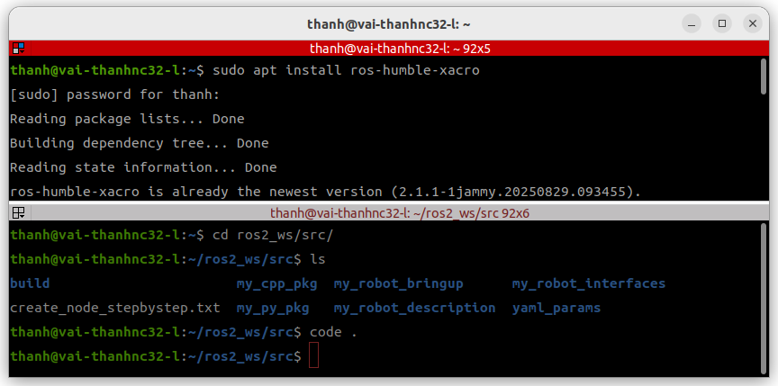
Make the URDF compatible with Xacro
Xacro (XML Macros) Xacro is an XML macro language. With xacro, you can construct shorter and more readable XML files by using macros that expand to larger XML expressions.
install xacro

Slide 33
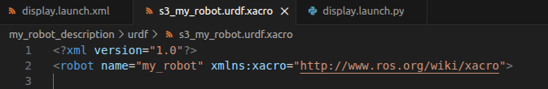
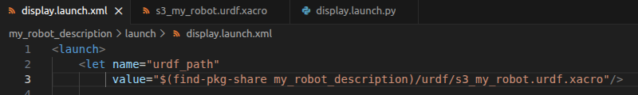
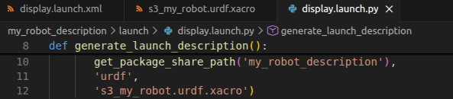
Make the URDF compatible with Xacro
In vs code
modify the urdf/s3_my_robot.urdf -> s3_my_robot.urdf.xacro
modify the content in s3_my_robot.urdf.xacro
1
2
3
update urdf path in display.launch.xml and display.launch.py

Slide 34
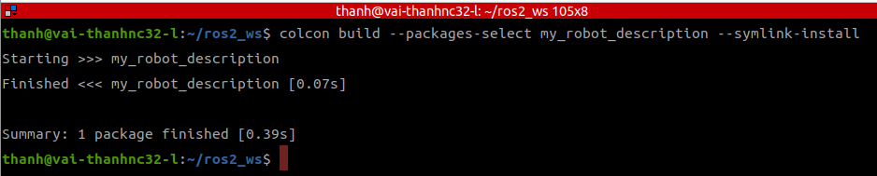
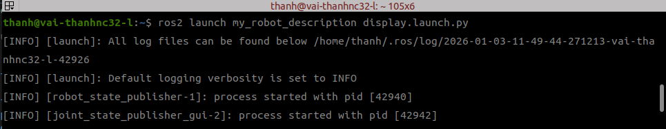
Make the URDF compatible with Xacro
build and run

Slide 35
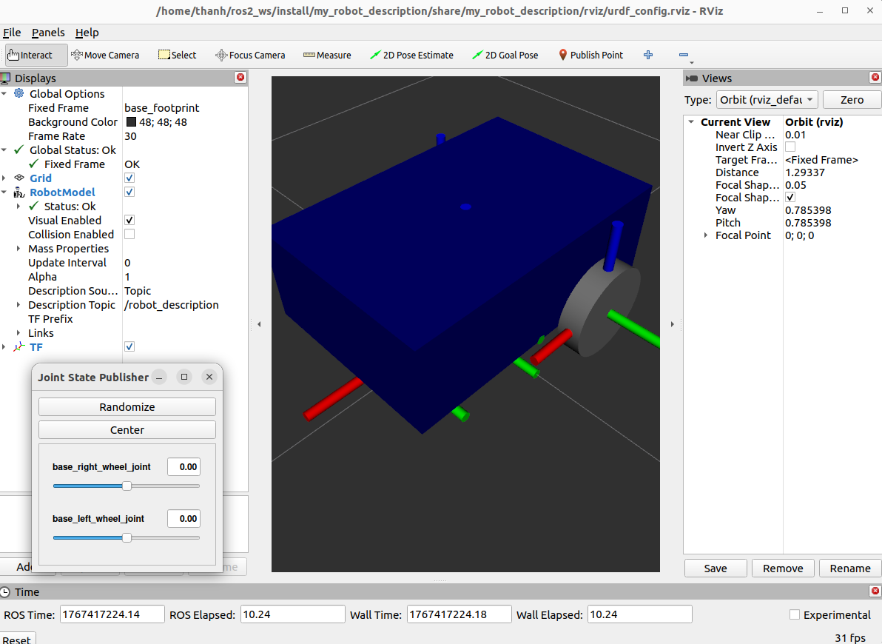
Make the URDF compatible with Xacro
display

Slide 36
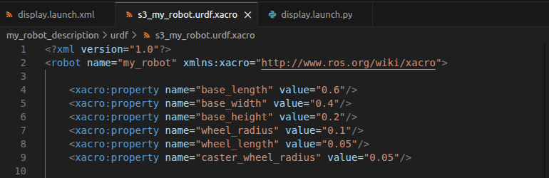
Create Variables with Xacro Properties
Modify the s3_my_robot.urdf.xacro by using variables as attached file

Slide 37
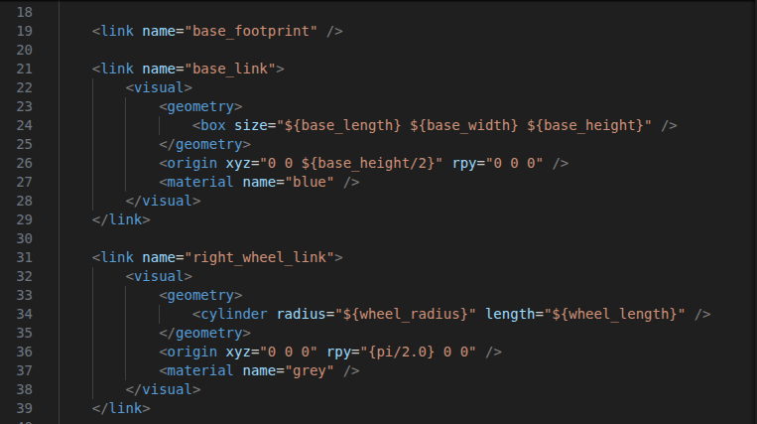
Create Variables with Xacro Properties
Modify the s3_my_robot.urdf.xacro by using variables as attached file

Slide 38
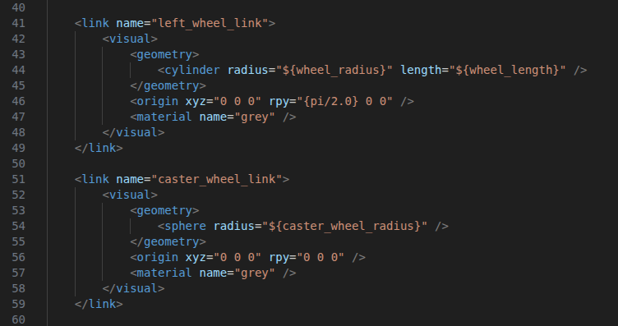
Create Variables with Xacro Properties
Modify the s3_my_robot.urdf.xacro by using variables as attached file

Slide 39
Create Variables with Xacro Properties
launching display.launch.py
ros2 launch my_robot_description display.launch.py

Slide 40
Create Functions with Xacro Macros
example macro
<xacro:macro name="example_macro" params="a b c">
<link name="dummy_link">
<visual>
<geometry>
<box size="${b} ${b} ${c}" />
</geometry>
</visual>
</link>
</xacro:macro>
<xacro:example_macro a="2" b="3" c="4"/>

Slide 41
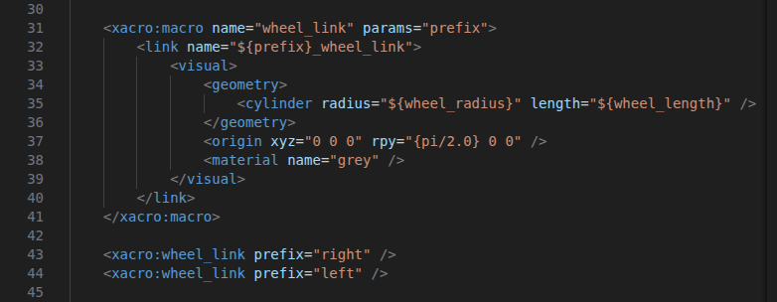
Create Functions with Xacro Macros
We apply Macros function for 2 wheel links as below

Slide 42

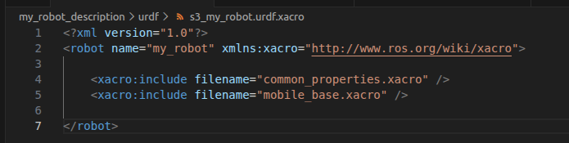
Include a Xacro File in Another Xacro File
Separate the s3_my_robot.urdf.xacro as 2 parts:
common_properties.xacro
mobile_base.xacro
And s3_my_robot.urdf.xacro is modified as

Slide 43
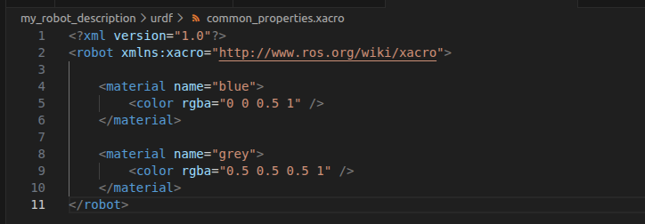
Include a Xacro File in Another Xacro File
common_properties.xacro configure the color properties

Slide 44
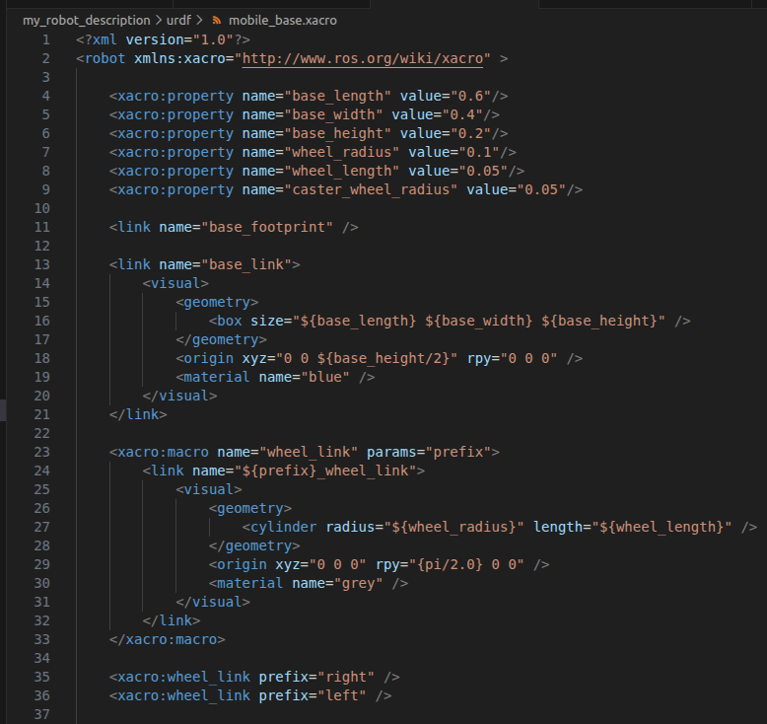
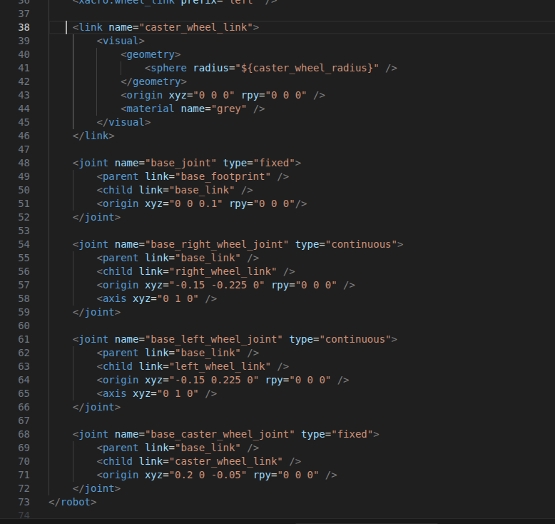
Include a Xacro File in Another Xacro File
the remains are in mobile_base.xacro

Slide 45
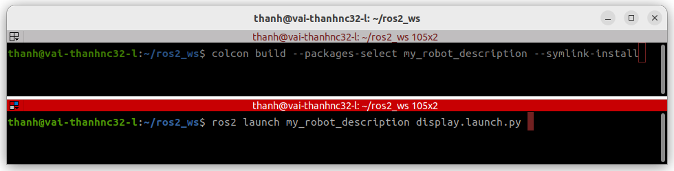
Include a Xacro File in Another Xacro File
Rebuild and run

